Slide 1
Hive
Dr.Preethi Ananthachari
Asst.Professor
Endicott College of International Studies
Woosong University

Slide 2
Introduction to Hive
Hive evolved as a data warehousing solution built on top of Hadoop Map-Reduce framework.
Though, Hadoop has proved useful for working on huge data sets,
MapReduce framework is very low level and it requires programmers to write custom programs which are hard to maintain and reuse.
Hive comes here for rescue of programmers.

Slide 3
Hive engine
It compiles queries into Map-Reduce jobs to be executed on Hadoop.
Hive operates on data stored in tables which consists of primitive data types and collection data types like arrays and maps.
Hive comes with a command-line shell interface which can be used to create tables and execute queries.

Slide 4
Hive Query
language is similar to SQL wherein it supports subqueries.
it is possible to take a MapReduce joins across Hive tables.
It has a support for simple SQL like functions– CONCAT, SUBSTR, ROUND etc., and aggregation functions– SUM, COUNT, MAX etc.
It also supports GROUP BY and SORT BY clauses. It is also possible to write user defined functions in Hive query language.

Slide 5
What is Hive?
Apache Hive is a data warehouse framework for querying and analysis of data stored in HDFS.
It provides SQL-like declarative language, called HiveQL, to express queries.
Using Hive-QL, users associated with SQL can perform data analysis very easily.

Slide 6
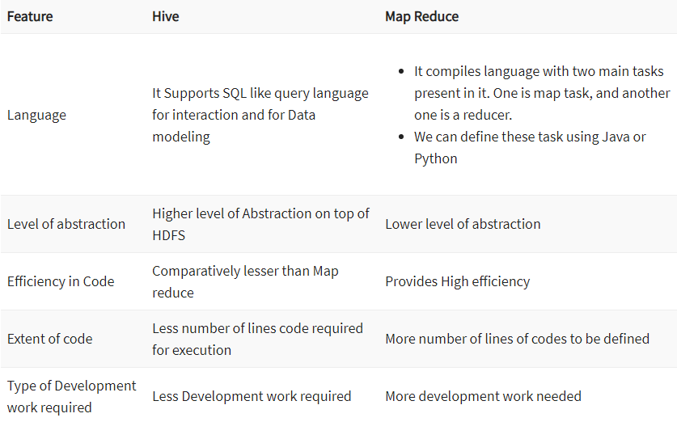
Hive Vs Map Reduce?

Slide 7
What is Hive?
Hive is an ETL and Data warehousing tool developed on top of Hadoop Distributed File System (HDFS).
Hive makes job easy for performing operations like
Data encapsulation
Ad-hoc queries
Analysis of huge datasets

Slide 8
Important characteristics of Hive
In Hive, tables and databases are created first and then data is loaded into these tables.
managing and querying only structured data
While dealing with structured data, Map Reduce doesn’t have optimization and usability features like UDFs but Hive framework does.
Query optimization refers to an effective way of query execution in terms of performance.

Slide 9
Hive’s SQL-inspired language separates the user from the complexity of Map Reduce programming.
It reuses familiar concepts from the relational database world, such as tables, rows, columns and schema, etc. for ease of learning.
Hadoop’s programming works on flat files. So, Hive can use directory structures to “partition” data to improve performance on certain queries.
A new and important component of Hive i.e. Metastore used for storing schema information. This Metastore typically resides in a relational database. We can interact with Hive using methods like

Slide 10
Web GUI
Java Database Connectivity (JDBC) interface
Generally, HQL syntax is similar to the SQL syntax. Sample query : Select * from <TableName>
Hive supports four file formats those are TEXTFILE, SEQUENCEFILE, ORC and RCFILE (Record Columnar File).
For single user metadata storage,
Hive uses derby database and for multiple user Metadata or shared Metadata case Hive uses MYSQL.

Slide 11
Some of the key points about Hive:
The major difference between HQL and SQL is that Hive query executes on Hadoop’s infrastructure rather than the traditional database.
The Hive query execution is going to be like series of automatically generated map reduce Jobs.
Hive supports partition and buckets concepts for easy retrieval of data when the client executes the query.
Hive supports custom specific UDF (User Defined Functions) for data cleansing, filtering, etc. According to the requirements of the programmers one can define Hive UDFs.

Slide 12
Hive Vs Relational Databases:-
By using Hive, we can perform some peculiar functionality that is not achieved in Relational Databases.
For a huge amount of data that is in peta-bytes, querying it and getting results in seconds is important.
And Hive does this quite efficiently, it processes the queries fast and produce results in second’s time.

Slide 13
Relational databases are of “Schema on READ and Schema on Write“. First creating a table then inserting data into the particular table. On relational database tables, functions like Insertions, Updates, and Modifications can be performed.
Hive is “Schema on READ only“. So, functions like the update, modifications, etc. don’t work with this. Because the Hive query in a typical cluster runs on multiple Data Nodes. So it is not possible to update and modify data across multiple nodes.( Hive versions below 0.13)
Also, Hive supports “READ Many WRITE Once” pattern. Which means that after inserting table we can update the table in the latest Hive versions.

Slide 14
Hive Consists of Mainly 3 core parts
Hive Clients
Hive Services
Hive Storage and Computing

Slide 15
Hive Clients:
Hive provides different drivers for communication with a different type of applications.
For Thrift based applications, it will provide Thrift client for communication.
For Java related applications, it provides JDBC Drivers.
Other than any type of applications provided ODBC drivers.
These Clients and drivers in turn again communicate with Hive server in the Hive services.

Slide 16
Hive Services:
Client interactions with Hive can be performed through Hive Services.
CLI is the command line interface acts as Hive service for DDL (Data definition Language) operations.
All drivers communicate with Hive server and to the main driver
Driver present in the Hive services represents the main driver, and it communicates all type of JDBC, ODBC, and other client specific applications.
Driver will process those requests from different applications to meta store and field systems for further processing.

Slide 17
Hive Storage and Computing:
Hive services such as Meta store, File system, and Job Client in turn communicates with Hive storage and performs the following actions
Metadata information of tables created in Hive is stored in Hive “Meta storage database”.
Query results and data loaded in the tables are going to be stored in Hadoop cluster on HDFS.

Slide 18
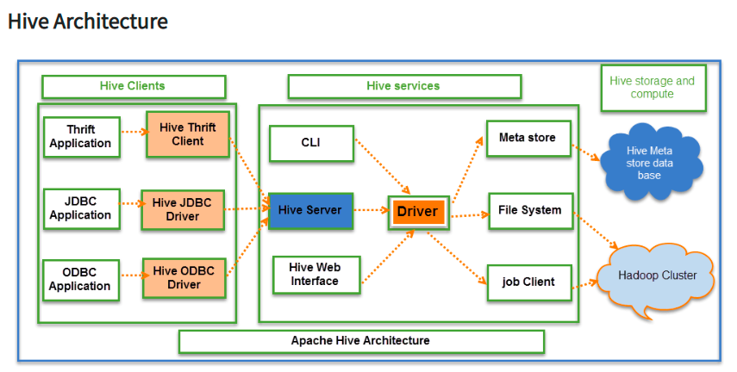

Slide 19
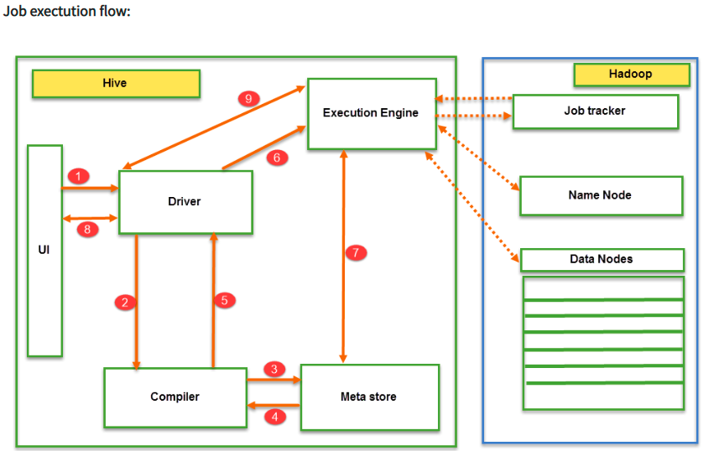

Slide 20
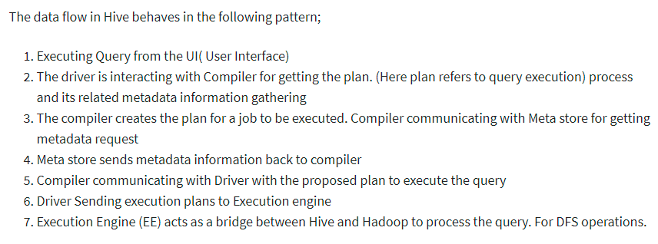

Slide 21
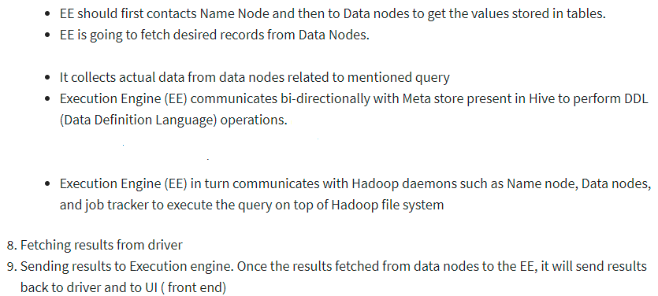

Slide 22
Reference
https://data-flair.training/blogs/apache-hive-architecture/

